Slide 1

EAST WEST COLLEGE OF ENGINEERING
(Affiliated to Visvesvaraya Technological University, Belagavi & Approved by AICTE, New Delhi)
Department of Computer Science & Engineering
Project Review
Presentation
on
Image Classification Using
Convolutional Neural Network (CNN)
Presented by:
Tushar V Aradhyamath
Under the guidance of:
Prof. Janaki K B
Assistant Professor
Dept. of Computer Science and Engineering

Slide 2

ABSTRACT
Image classification is a critical computer vision task facing limitations with
traditional methods. This project addresses this by developing a robust and
efficient image recognition model utilizing Convolutional Neural Networks
(CNNs), the state-of-the-art in deep learning. Built using Python, TensorFlow, and
Keras, the work focuses on the construction, training, and evaluation of a CNN-
based system to demonstrate the superior accuracy and practical performance of
AI-powered techniques in modern visual data categorization.
Dept of CSE, EWCE
Image Classification using AI

Slide 3
INTRODUCTION
• Image classification is a key task in computer vision, enabling machines to
categorize images into predefined classes.
• Traditional classification methods struggle with complex patterns and large
datasets, making deep learning essential.
• AI-powered techniques, particularly convolutional neural networks (CNNs),
have revolutionized image recognition.
• This project leverages Python, TensorFlow, and Keras to develop an efficient
image classification model.
Dept of CSE, EWCE
Image Classification using AI

Slide 4

PROBLEM STATEMENT
Develop a Convolutional Neural Network (CNN) model to accurately classify
images of flowers into distinct categories such as daisy, rose, sunflower, tulip, and
dandelion.
The model aims to automate flower identification by learning intricate visual
patterns from image data, enabling applications in botany, education, and mobile
plant recognition tools.
Dept of CSE, EWCE
Image Classification using AI

Slide 5

LITERATURE SURVEY
Title of the paper
Year
Authors
Summary
Advantages
Limitations
“Integrating
Transfer Learning
with Python-
based CNNs for
Enhanced Image
Classification”
2024 Dr. James
Lee, Dr.
The article discusses using
transfer learning with Python-
based CNNs to improve image
classification. It leverages pre-
trained models (e.g., VGG,
ResNet) to enhance
performance on small datasets
by fine-tuning layers.
Implemented with TensorFlow,
Keras, or PyTorch, it reduces
training time and boosts
accuracy. Challenges like
overfitting are addressed
through data augmentation and
regularization, with examples
in medical and natural image
classification.
•
Demonstrates
improved
classification
accuracy with
effective transfer
learning.
•
•
Scalability to
very large,
diverse datasets
requires further
validation.
Robustness
under varying
environmental
conditions
(e.g., lighting,
occlusions) is
not fully
Anna
Garcia
•
•
Lowers
computational
costs by building
upon established
architectures.
Enhances user
accessibility
through
addressed.
streamlined web
deployment.
Dept of CSE, EWCE
Image Classification using AI

Slide 6

LITERATURE SURVEY
Title of the paper
Year
Authors
Summary
Advantages
Limitations
“Streamlit-
Powered AI:
Democratizing
Image
Classification
through
2025 Prof. David The article discusses how
•
•
Lowers the barrier
to entry for non-
expert users by
providing an
intuitive interface.
Enables
immediate visual
feedback and
dynamic model
performance
•
•
Requires
additional
Kim, Dr.
Lucy
Streamlit simplifies building
interactive web apps for image
classification, making AI
accessible to non-technical
users by integrating with tools
like FastAI and PyTorch,
reducing web development
complexity.
testing across
broader and
more diverse
datasets.
Security and
scalability
aspects of the
web-based
deployment
need further
exploration.
Martinez,
Dr. Robert
Nguyen
Accessible
Interfaces”
monitoring.
•
Facilitates an end-
to-end integration
from data
processing to user
deployment.
Dept of CSE, EWCE
Image Classification using AI

Slide 7
LITERATURE SURVEY
Title of the paper
Year
Authors
Summary
Advantages
Limitations
“Exploring
Hybrid
2025 Dr. Anil
Mehta, Dr.
The article examines
•
Enhances feature
extraction
capabilities,
improving
accuracy on
complex images.
Provides better
interpretability
through attention
visualizations.
Demonstrates
potential
applicability in
critical domains
like medical
imaging.
•
Increased
combining different deep
learning models, like CNNs
and transformers, to enhance
image recognition
performance. It discusses how
hybrid architectures leverage
the strengths of each model to
improve accuracy and
computational
complexity
may limit real-
time
performance on
resource-
constrained
devices.
Future research
is needed to
optimize the
model for
Architectures for
Improved Image
Recognition: A
Deep Learning
Approach”
Priya Rao
•
•
efficiency in tasks like object
detection and classification.
•
mobile or edge
deployments.
Dept of CSE, EWCE
Image Classification using AI

Slide 8
REQUIREMENTS
Software Requirements:
• Python 3.x
• TensorFlow, Keras
• Streamlit
• OpenCV / PIL (Optional for image preprocessing)
• Optionally Flask / FastAPI (if separating backend)
Hardware Requirements:
• GPU (for training phase, optional during inference)
• Minimum 8 GB RAM, recommended 16GB+
• Sufficient storage for dataset and models
Dept of CSE, EWCE
Image Classification using AI

Slide 9
METHODOLOGY
Step 1: Data Collection & Preprocessing
• Obtain a diverse and balanced dataset (e.g., ImageNet, CIFAR-10, or custom).
• Preprocess: resize, normalize, and augment images to increase generalization.
Step 2: Model Building
• Build a custom CNN or use transfer learning from pretrained models.
• Add fully connected layers and softmax for classification.
• Apply regularization (dropout, batch normalization) to prevent overfitting.
Step 3: Training & Evaluation
• Train using backpropagation and optimize with Adam or SGD.
• Evaluate using validation set; tune hyperparameters.
• Use early stopping or learning rate schedulers for efficiency.
Dept of CSE, EWCE
Image Classification using AI

Slide 10
METHODOLOGY
Step 4: Integration with Streamlit
• Create a web app interface where users can upload images.
• Load the trained model and run inference on uploaded images.
• Display results (predicted class, confidence score, image preview).
Step 5: Deployment & Feedback
• Deploy locally or on cloud platforms (optional).
• Collect feedback for continuous improvement.
• Update dataset and retrain periodically.
Dept of CSE, EWCE
Image Classification using AI

Slide 11
SYSTEM ARCHITECTURE
1. User Interface Layer:
• The Streamlit web app lets users upload images and instantly see predicted
classes, confidence scores, and visual model feedback.
• It can also display overall model metrics and sample output images.
2. Application Layer:
• The prediction pipeline receives images from the system, preprocesses them for
the CNN model, performs classification, formats the results, and returns the
predicted label and confidence score back to Streamlit for display.
Dept of CSE, EWCE
Image Classification using AI

Slide 12
SYSTEM ARCHITECTURE
3. Model Layer:
• The CNN model is trained on a labeled flower dataset and uses transfer learning
and data augmentation for improved accuracy, with TensorFlow and Keras.
4. Data Layer:
• The training dataset is organized for supervised learning and includes both
original and augmented data, while model artifacts—like weights, architecture,
and logs—are saved for inference and monitoring.
Dept of CSE, EWCE
Image Classification using AI

Slide 13
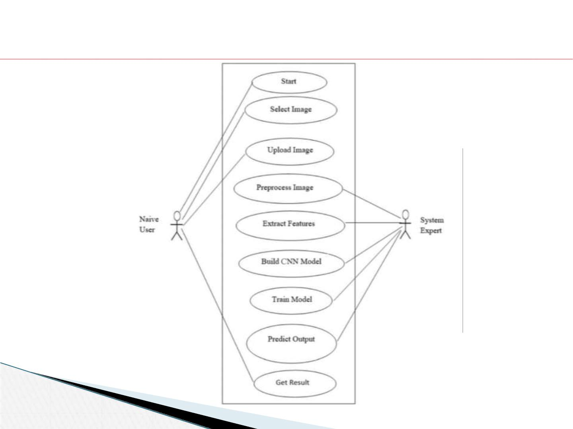
USE CASE DIAGRAM
Dept of CSE, EWCE
Image Classification using AI

Slide 14

Use Cases for Naive User
• Start: User initiates the system to begin the classification workflow.
• Select Image: User chooses the image to be classified from the local system or
another source.
• Upload Image: User uploads the selected image for processing.
• Predict Output: User requests the system to classify the uploaded image and
produce a result.
• Get Result: User receives the final classification result or output from the
system.
Dept of CSE, EWCE
Image Classification using AI

Slide 15
Use Cases for System Expert
• Preprocess Image: System Expert handles image preprocessing steps, such as resizing,
normalization, or filtering, to make the image suitable for feature extraction and CNN
input.
• Extract Features: Expert engineers extract critical features from the image needed for
effective classification.
• Build CNN Model: Expert designs and develops the CNN architecture, optimizing
layers and parameters for high performance.
• Train Model: Expert trains the CNN model using labeled datasets to learn the patterns
needed for efficient image classification.
• Predict Output: Expert can also run the model to predict the class of uploaded images
and validate or interpret results.
• Get Result: System Expert verifies or interprets the output from the classification
process.
Dept of CSE, EWCE
Image Classification using AI

Slide 16
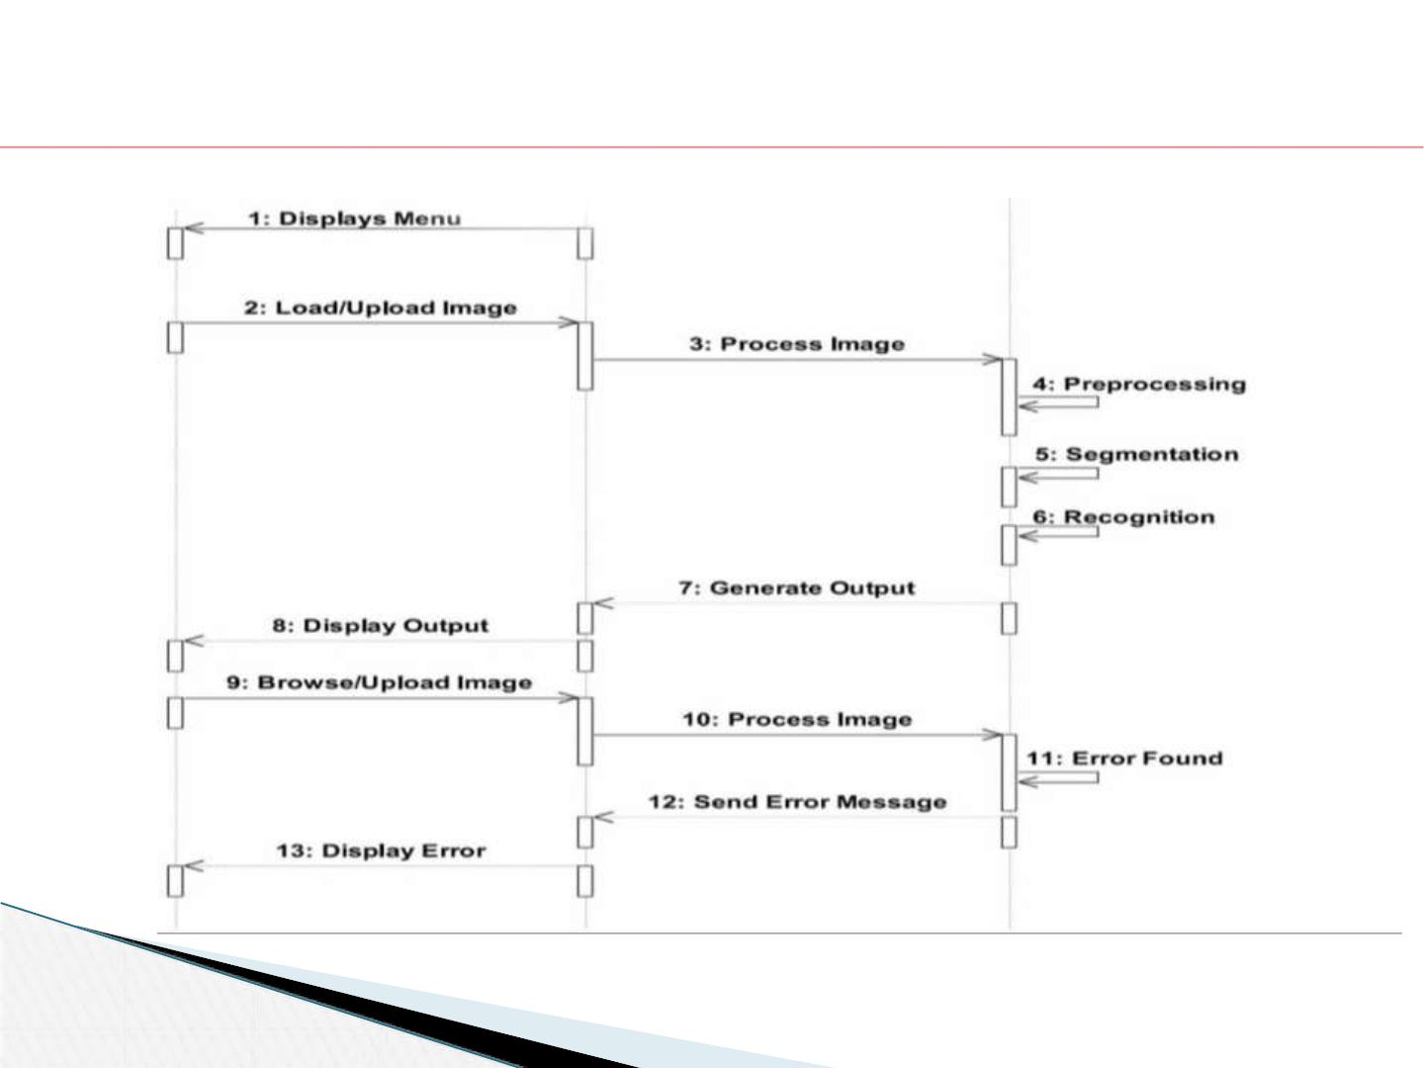
SEQUENCE DIAGRAM
User
GUI
CNN Model
Dept of CSE, EWCE
Image Classification using AI

Slide 17
Key Actors and Their Roles
• User: Initiates interaction by uploading or browsing images, receives classification
results or error messages, and uses the output for further decisions.
• GUI (Graphical User Interface): Acts as the intermediary layer between the user
and the underlying CNN model, displaying menus, handling uploads, triggering
processing, showing outputs, and managing error messaging.
• CNN Model: Responsible for the technical core tasks such as image
preprocessing, segmentation, image recognition, and error detection during
processing.
Main Process Flow
• The User starts by viewing the menu, then uploads or browses images through the
GUI.
​
Dept of CSE, EWCE
Image Classification using AI

Slide 18
• The GUI receives the image, processes it, and sends it to the CNN Model.
• The CNN Model undertakes a series of tasks: preprocessing (cleaning and preparing the
image data), segmentation (dividing the image into meaningful sections), and recognition
(identifying objects or classifying the image).
• Once processing is complete, the output is generated and displayed to the User via the GUI.
• If an error is detected during processing, the system sends an error message back to the GUI
and notifies the User.
Technologies Used
• GUI Layer: Typically built with web frameworks such as Streamlit, Flask, Django, or
desktop frameworks like Tkinter or PyQt, allowing image uploads and result display.
• CNN Model: Implemented using deep learning libraries like TensorFlow or Keras to
perform image preprocessing, segmentation, and classification.
• Communication: Data flow between the GUI and CNN Model can use REST APIs or direct
function calls in Python-based platforms.
Dept of CSE, EWCE
Image Classification using AI

Slide 19

FLOW DIAGRAM
Dept of CSE, EWCE
Image Classification using AI

Slide 20
How the Process Starts
• Start: The workflow begins when the user or system initiates the image
classification process.
• Upload Image: The user uploads an image to the system, which serves as the
input for the entire pipeline.
Core Steps
• Preprocess Image: The system preprocesses the uploaded image, typically
involving resizing, normalization, and noise reduction to ensure consistent
input for feature extraction.
• Extract Features: Crucial image features are extracted, capturing patterns and
data needed for effective discrimination between classes.
Dept of CSE, EWCE
Image Classification using AI

Slide 21
• Build CNN Model: The system constructs the architecture of the CNN
(designing layers, nodes, and configuration suitable for the task).
• Train Model: The CNN model is trained using labeled data, allowing it to
learn feature representations and improve accuracy.
How the Process Ends
• Predict Model: After training, the CNN model makes predictions (classifies)
on new images based on learned patterns.
• End: The workflow concludes, and the final result—classification output or
prediction—is delivered, completing the process.
Dept of CSE, EWCE
Image Classification using AI

Slide 22
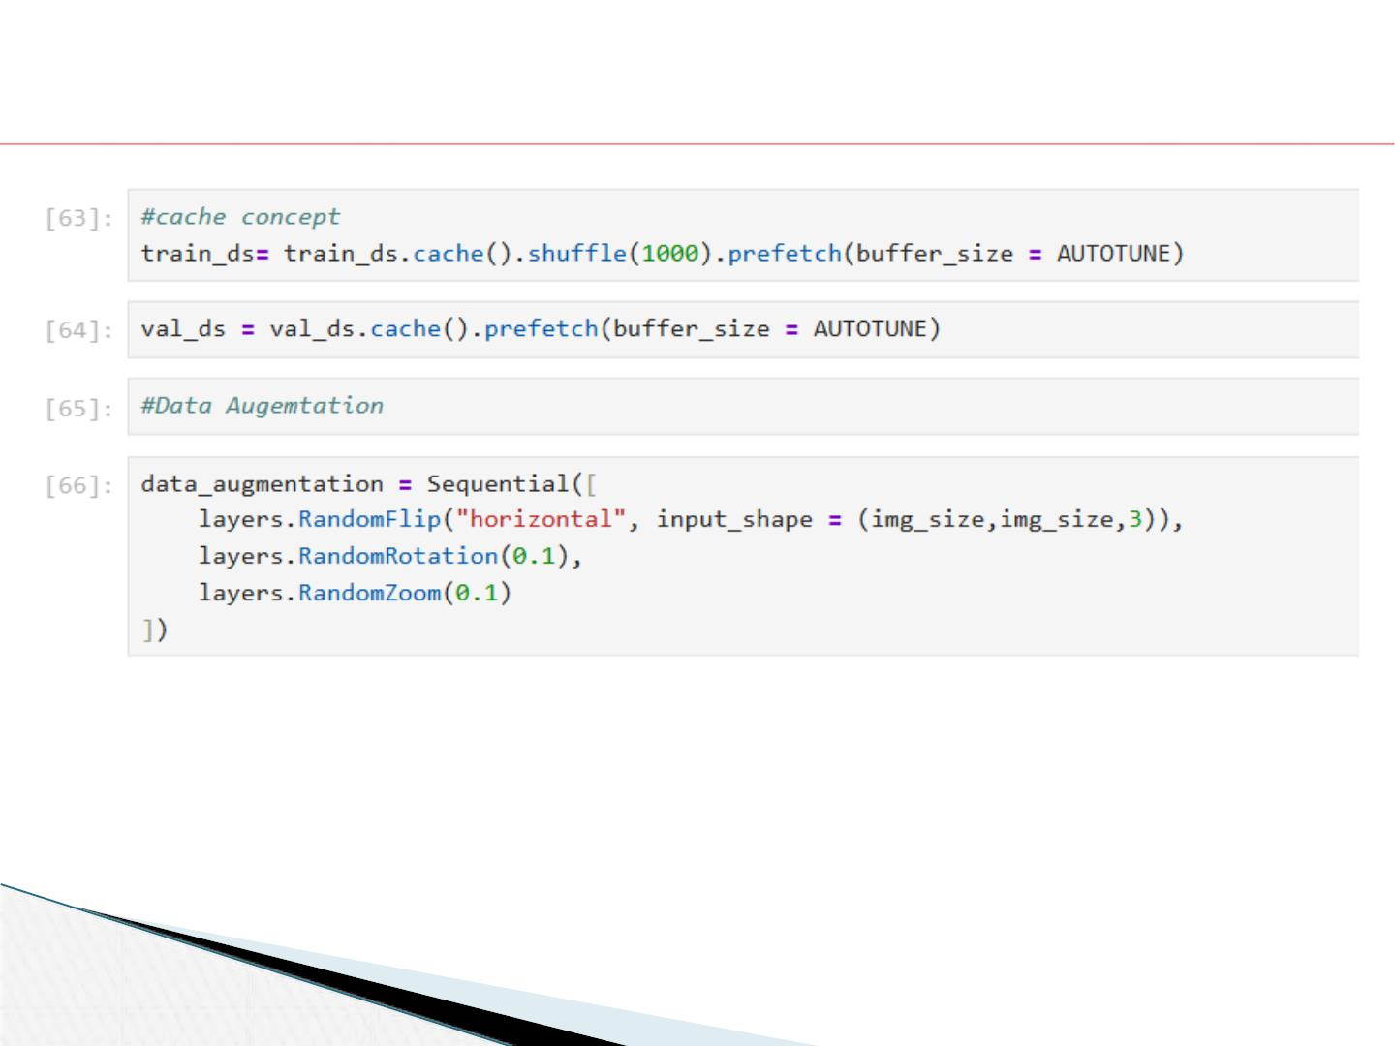
Algorithms And Techniques
Dept of CSE, EWCE
Image Classification using AI

Slide 23
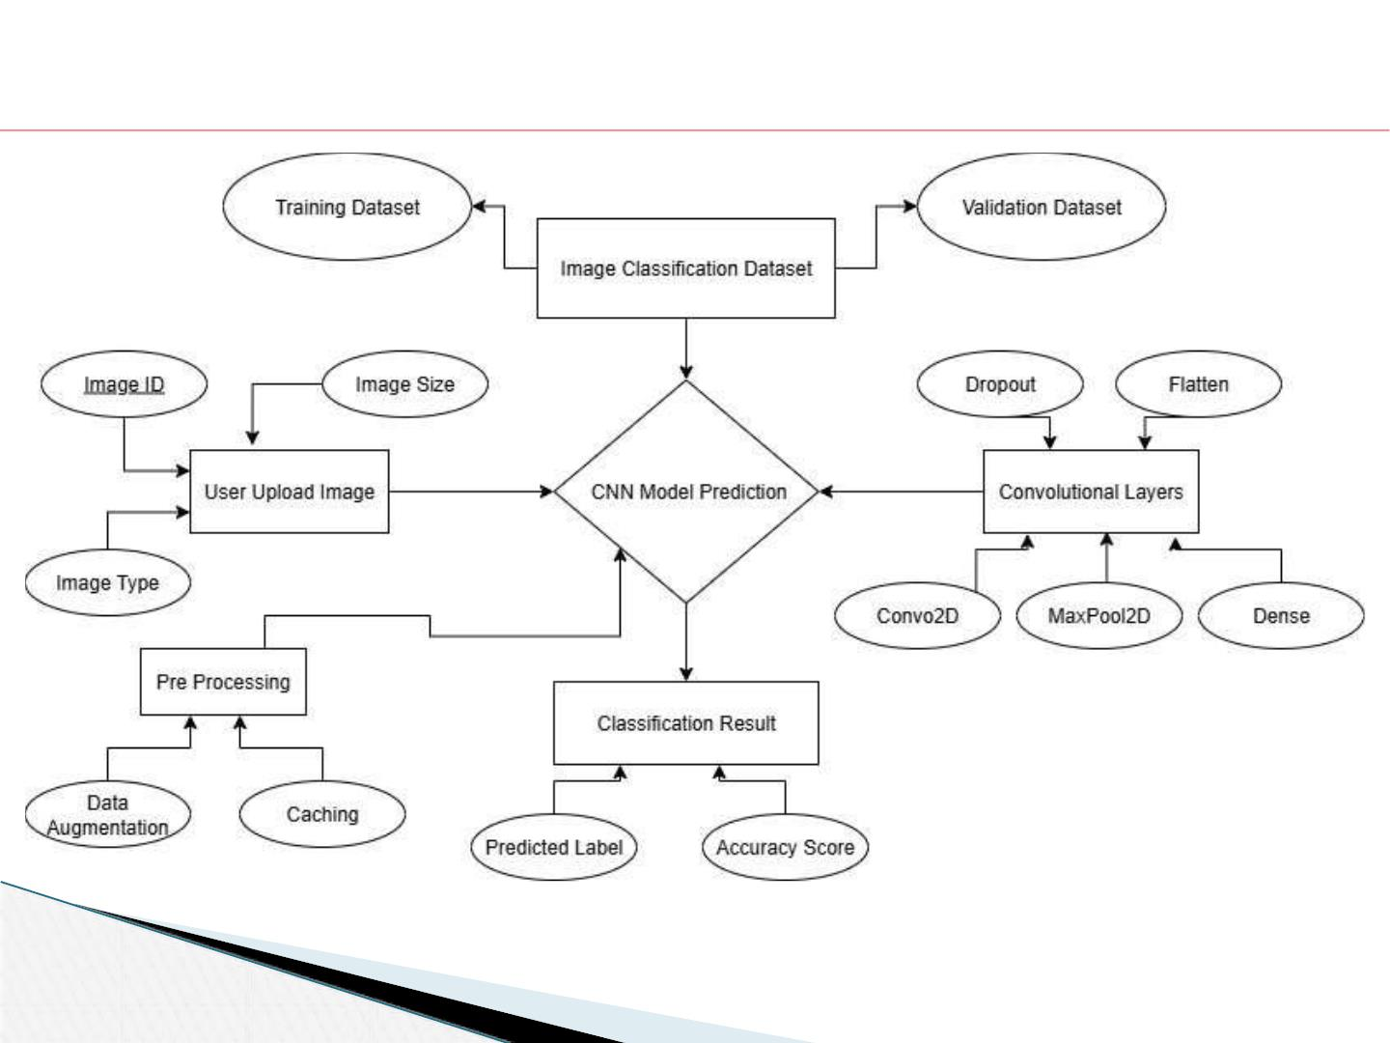
ER DIAGRAM
Dept of CSE, EWCE
Image Classification using AI

Slide 24
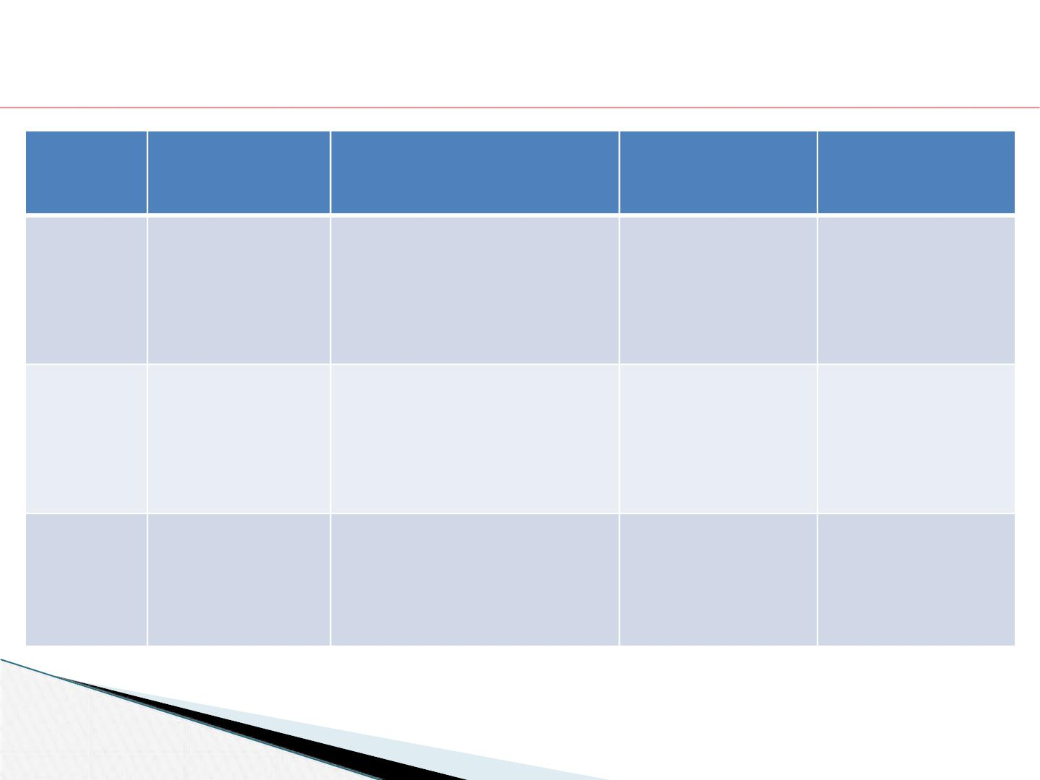
TEST CASES
Test Case Test Scenario
No.
Test Steps
Expected Result
Approved/
Rejected
TC 1
TC 2
TC 3
Image Upload
Functionality
Upload a valid image file via Image uploads
Approved
the Streamlit interface.
successfully,
thumbnail preview
displays without
errors.
Image
Preprocessing
Check if the uploaded image Image size
Approved
is resized and normalized
correctly before prediction. input size; pixel
values normalized
matches model
to range
Prediction
Accuracy
Upload a labeled test image Model returns
Approved/
Rejected (Based
on Score)
(e.g., dandelion) and verify
the classification result.
correct label with
accuracy
confidence >90%.
Dept of CSE, EWCE
Image Classification using AI

Slide 25

TEST CASES
Test Case Test Scenario
No.
Test Steps
Expected Result
Approved/
Rejected
TC 4
TC 5
TC 6
Data
Augmentation
Effect
Evaluate model predictions Predictions remain
Approved
on
consistent and
augmented/flipped/rotated accurate despite
versions of test images.
augmentations.
Real-time
Response
Measure time taken from
image upload to display of
prediction result in web
app.
Prediction results
shown within an
acceptable time
frame.
Approved/
Rejected (Based
on Score)
Error Handling
Upload invalid or corrupted System displays
Approved
files or unsupported
formats to test robustness.
incorrect label and
less accuracy
score
Without crashing
Dept of CSE, EWCE
Image Classification using AI

Slide 26
RESULT
The system accurately classifies any uploaded flower image into its respective
category, and displays an accuracy score representing the model’s confidence in
this prediction. The accuracy score (e.g., 96.7418%) shows how certain the deep
learning model is about its classification, with higher percentages indicating
stronger confidence. This helps users quickly verify both the predicted label and
how reliably the AI recognized the object in the image.
Dept of CSE, EWCE
Image Classification using AI

Slide 27
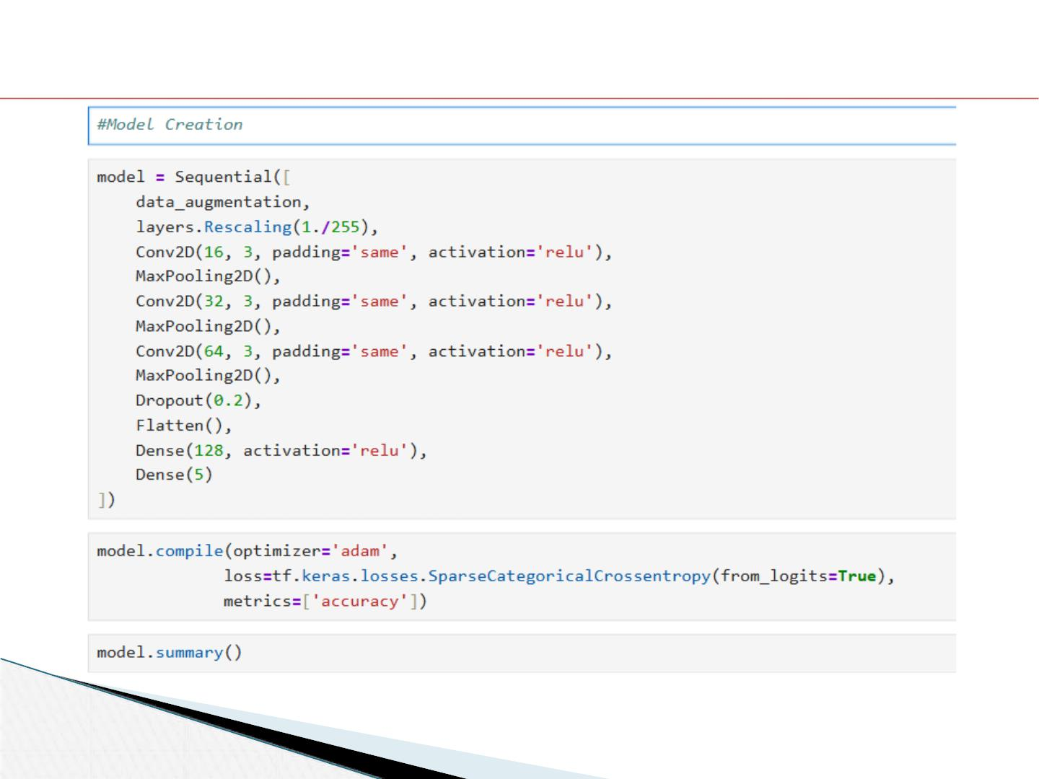
Model Creation
Dept of CSE, EWCE
Image Classification using AI

Slide 28
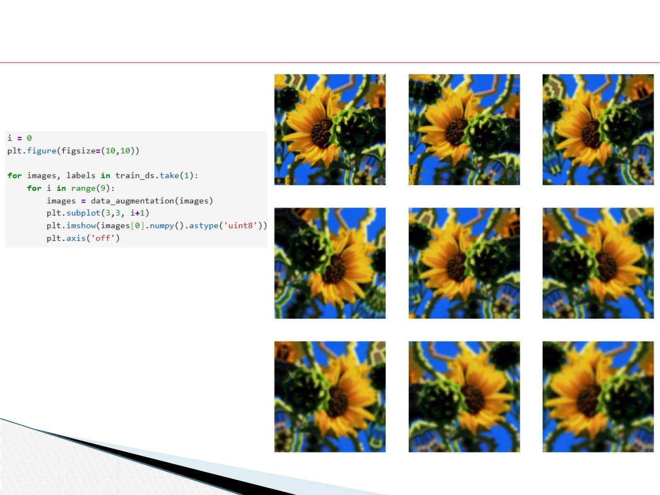
Data Augmentation
Dept of CSE, EWCE
Image Classification using AI

Slide 29
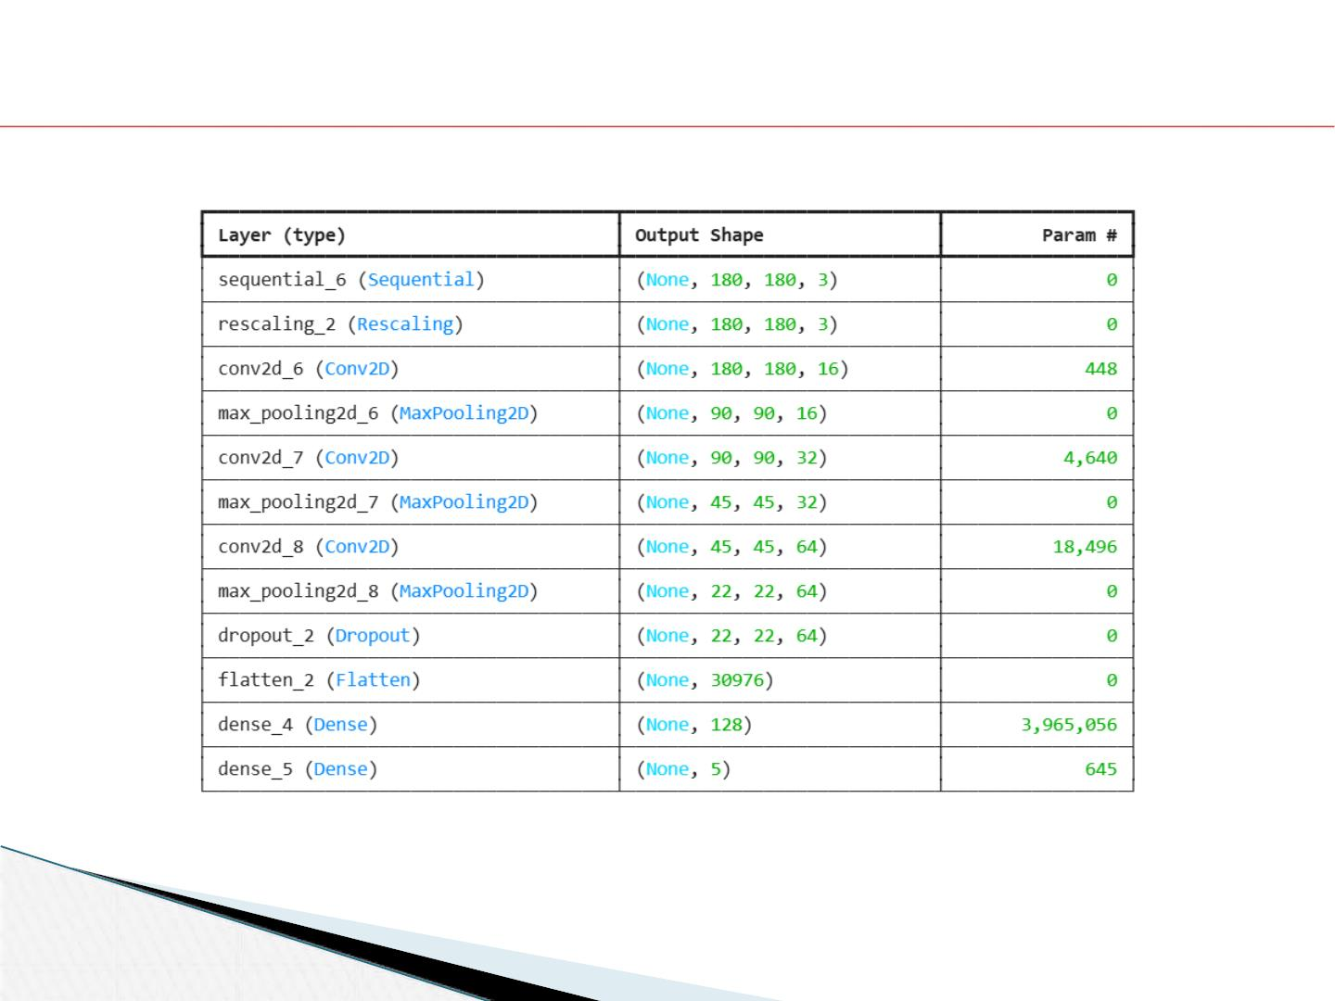
Various Layers implemented in CNN Model
Dept of CSE, EWCE
Image Classification using AI

Slide 30
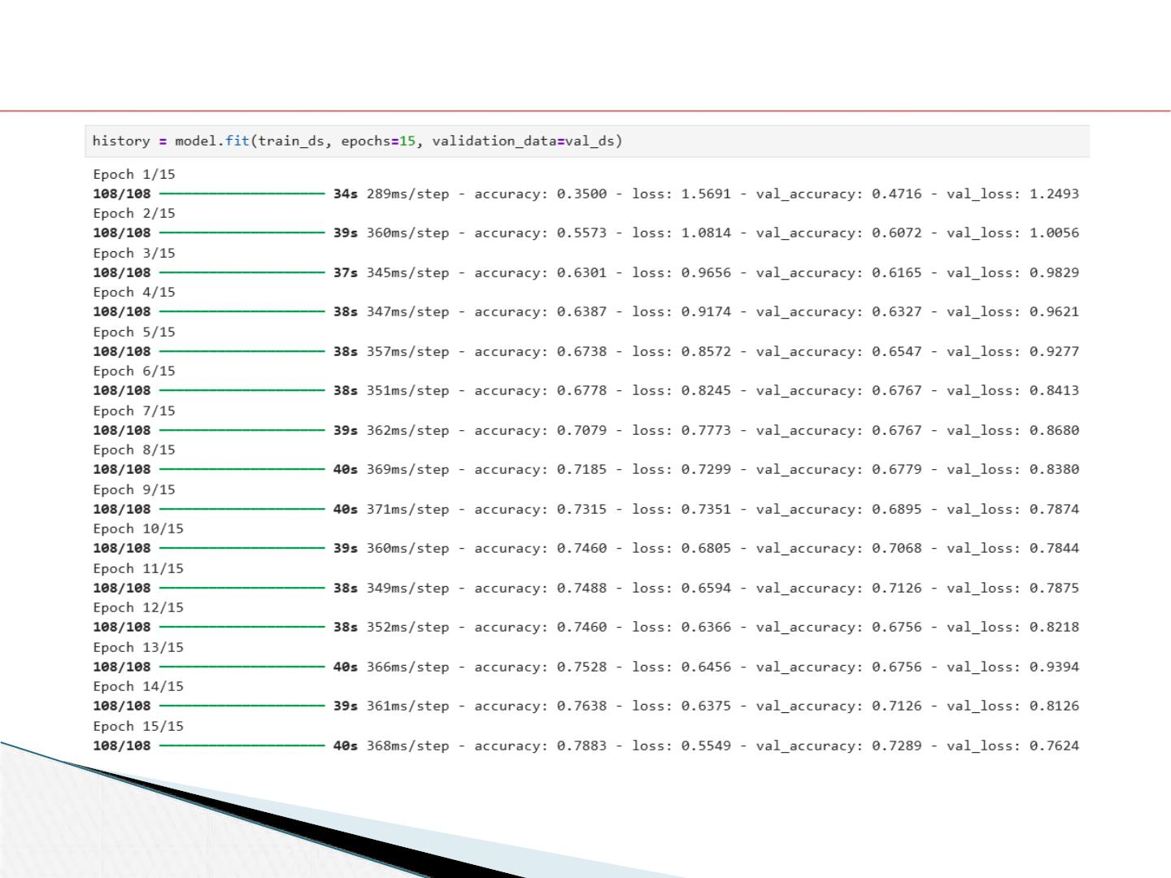
Model Training
Dept of CSE, EWCE
Image Classification using AI

Slide 31
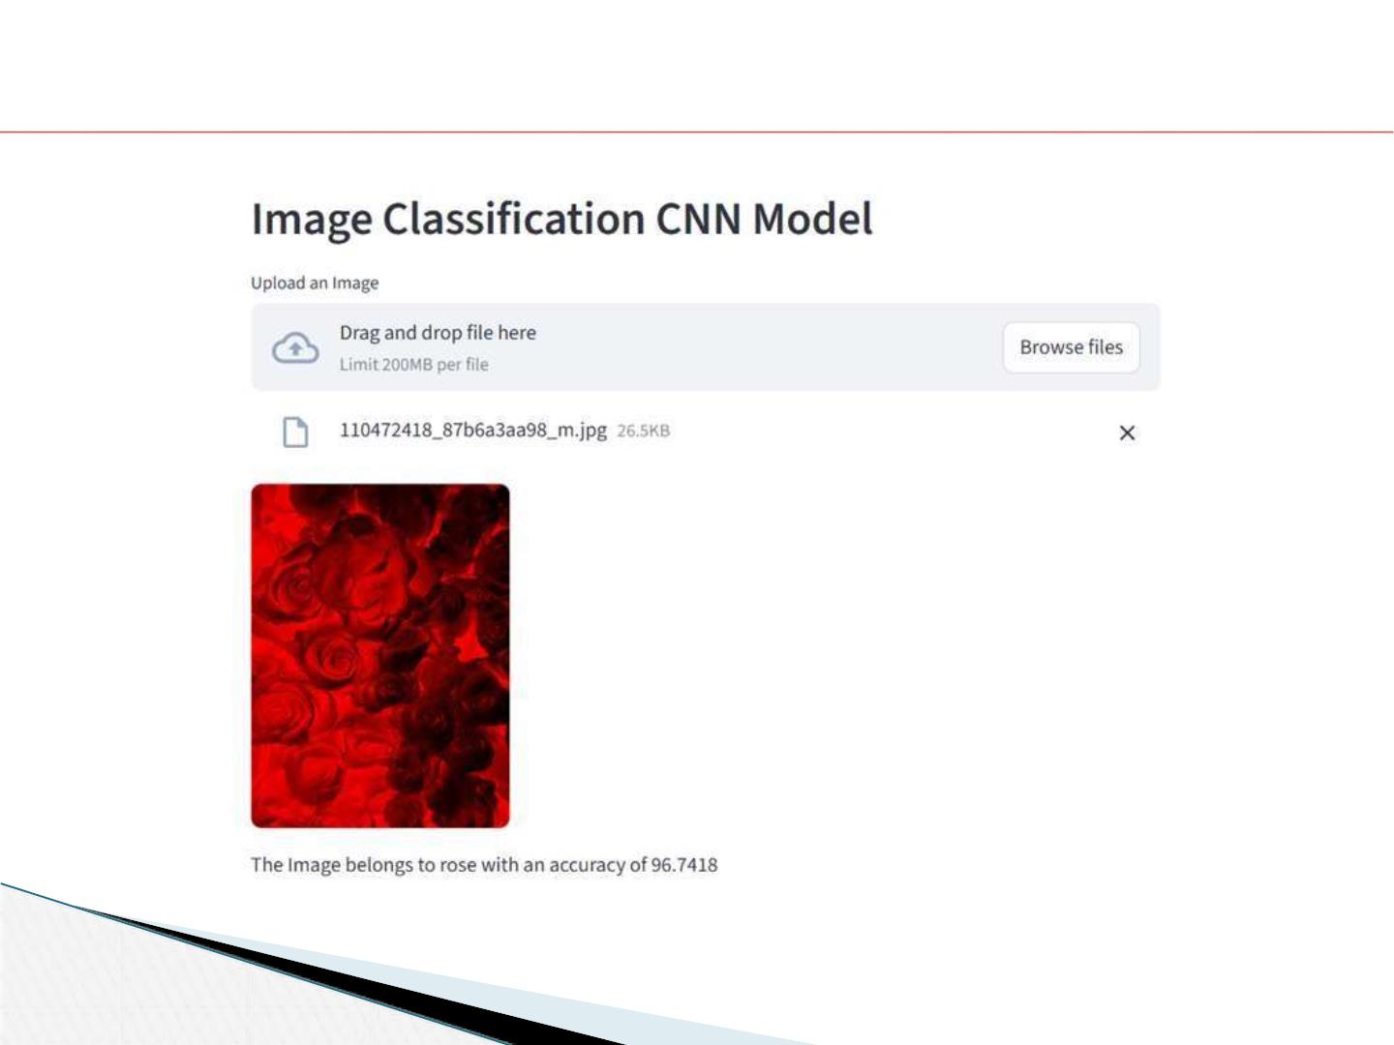
Classification along with Accuracy Score
Dept of CSE, EWCE
Image Classification using AI

Slide 32
CONCLUSION
This project demonstrates a robust AI-powered image classification system using
TensorFlow and Keras, deployed with Streamlit for user-friendly interaction. By
uploading a flower image, users receive an instant category prediction and an
accuracy score, reflecting the model’s confidence. The project showcases
effective application of deep learning for automated visual recognition, paving the
way for intelligent, real-time classification in areas like botany, agriculture, and
educational tools.
Dept of CSE, EWCE
Image Classification using AI

Slide 33
FUTURE ENHANCEMENT
Advanced Model Capabilities
• Attention and feature fusion modules boost accuracy for complex flowers.
• Self-supervised and transfer learning let models adapt to new species using
unlabeled data.
• Deploying on edge devices enables instant predictions for mobile and IoT.
User Interaction and Experience
• Batch image upload accelerates classification for groups.
• Multimodal input supports both image and text/audio for richer predictions.
• Explainable AI tools help users see and trust how predictions are made.
Dept of CSE, EWCE
Image Classification using AI

Slide 34
REFERENCES
[1] TensorFlow Core Documentation: Convolutional Neural Networks, Data
Augmentation, and Image Classification Tutorials
[2] IRJMETS. "Image Classification of CIFAR10 Using CNN", International Research
Journal of Modernization in Engineering, Technology and Science, Vol 4, Issue 3 (2022)
[3] Neptune.ai, "Data Augmentation in Python: Everything You Need to Know" (2025)
[4] GitHub, "Image Classification using CNN Keras and TensorFlow in Python"
[5] Pluralsight, "Deploying Image Classification on the Web with Streamlit and Heroku"
[6] PyImageSearch, "Data Augmentation with tf.data and TensorFlow"
[7] IJAERD, "Image Classification with Deep Learning and Comparison between Different
Convolutional Neural Network Structures using Tensorflow and Keras"
[8] Lillesand, T.M., Kiefer, R.W., Chipman, J.W., "Remote Sensing and Image
Interpretation," 5th Edition, Wiley, 2004
[9] Li Deng, Dong Yu, "Deep Learning: Methods and Applications," Microsoft Research
[10] Yann LeCun, Leon Bottou, Yodhua Bengio, Patrick Haffner, "Gradient-Based
Learning Applied to Document Recognition," Proceedings of the IEEE, November 1998
Dept of CSE, EWCE
Image Classification using AI

Slide 35
Thank You
Dept of CSE, EWCE
Image Classification using AI

